Slide 1
- NOVA IMS 2021-
Predictive Hotel Booking Cancellations
Bruno Filipe Prazeres Soares, number: 20200658
Xavier Golaio Gonçalves, number: 20201090
Lilou Dang-Thai, number: 20200743
CREATIVE TEMPLATE

Slide 2
NOVA IMS. 2021
Business Objectives
Data Mining Goals
Business Problem

Slide 3
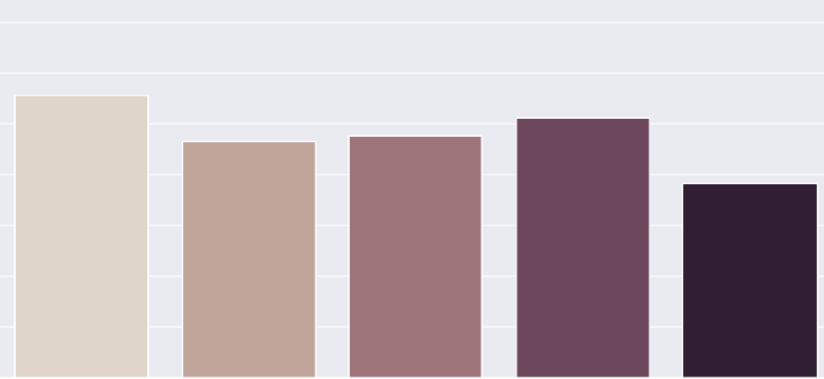
NOVA IMS. 2021
Model Selection
Comparison of F1 Score Models
1.0
0.9
0.8
0.7
0.6
Random Forest
Decision Tree
Neural Network
Stacking Classifier
Logistic Regression

Slide 4
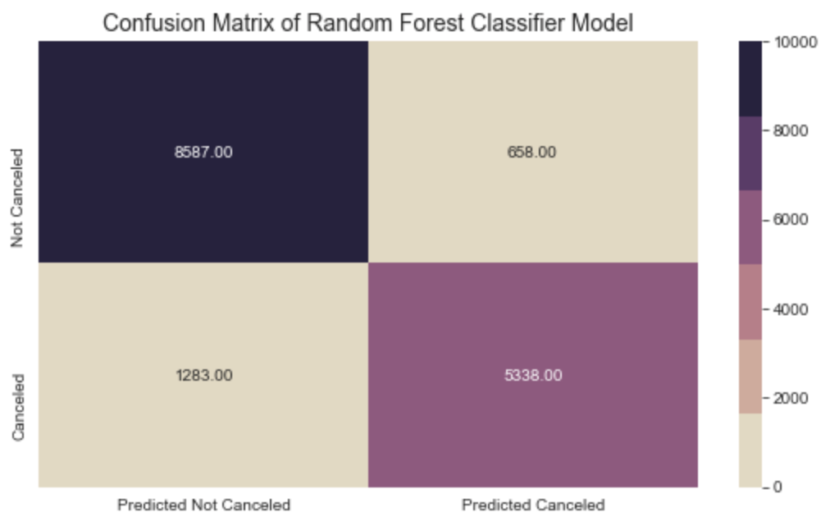
Evaluation and Results
Confusion Matric of Random Forest Classifier
Precision : 0.89
Recall : 0.80
Accuracy : 0.87
F1 Score : 0.87
10 000
Not Cancelled
Cancelled
0
Predicted Not Cancelled
Predicted Cancelled
NOVA IMS. 2021

Slide 5
NOVA IMS. 2021
Strategy
Synchronizing Predictive Model with the Hotel Central Reservation System and Property Management System.
Constant update of relevant data in system.
Avoid potential cancellations detected by the model by offering advantages.

Slide 6
NOVA IMS. 2021
Consideration for
Model Improvement
Feature of Deposit Type with good and reliable information
More data
More Features such as :
Price level
Weather Information
Reputation
Exchange Rates

Slide 7




Questions
Thank you !
NOVA IMS. 2021

